Slide 1

Make-or-Break:
A Natural Disaster Simulation Game
Group 5: Esat Duman, Jonathan Juarez, Kent Lizardo, Jose Tejeda

Slide 2

Make or Break: Overview
Make or Break is a game that uses real-time physics simulations in order to test virtual buildings against the forces of nature.
Make or Break allows users to create, edit, and test their designs against against natural disasters like earthquakes, floods, or tornadoes.
In Challenge Mode, where users can test buildings in order to survive certain challenges of varying difficulties. In Sandbox Mode users get to make buildings with an infinite budget and create disasters of their own.
Notes:
skzjc;ldjslfa

Slide 3
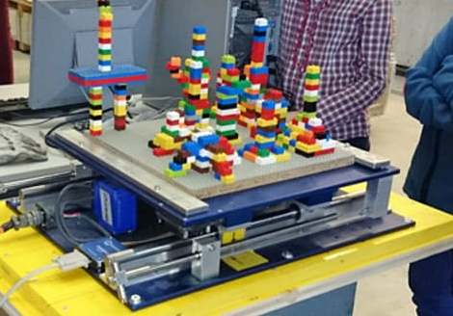
Purpose
Make-or-Break provides a platform that empowers users to simulate and test the structural integrity of buildings against various natural disasters.
By offering a real-time physics simulation, the application aims to assist designers, engineers, and architects in designing safer and more resilient structures.
The goal behind this project seeks to help create safer environments, while also promoting safety and sustainability in construction practices.

Slide 4
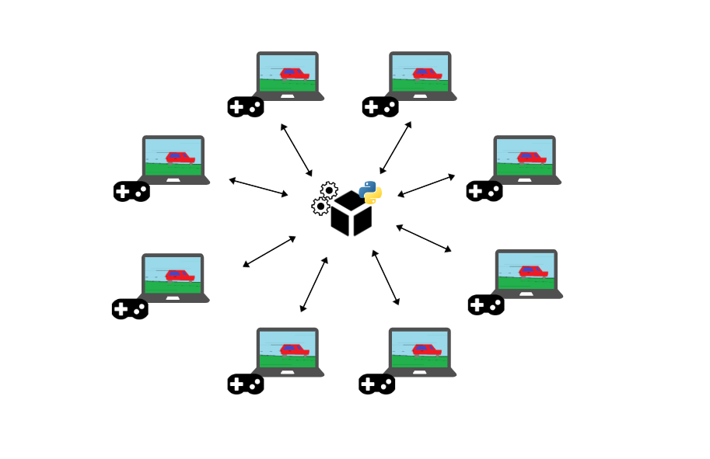
Key Requirements
Precision or Accuracy: Physics calculations must employ fixed physics timestep solutions to ensure accuracy and consistency.
Robustness or Fault-Tolerance: The levels downloaded by the users will still be playable on their systems regardless of server connection.
Adaptability: Make or Break is a PC game so will be compatible with Windows, Mac-OS, and Linux. Will be available on many different gaming platforms like steam, geforce Now, and Epic Games.
Appearance: The appearance should be user friendly, simple and appealing. Fonts throughout the interface should be easy to read. Lighter colors of choice will be used and darker colors will be avoided to make it easy for the client to navigate the game.

Slide 5


Design Goals
The design of Make-or-Break aims for a balance between realism and entertainment. Keeping this in mind the main design objectives for Make or break are:
Physics Simulations: Realistic depictions of natural forces on structures
Scalability: Wide range of building sizes / varying magnitudes of disasters
Performance Optimization: Smooth and responsive simulations on varying hardware
Education Value: Introduces engineering principles, and disaster preparedness / awareness

Slide 6
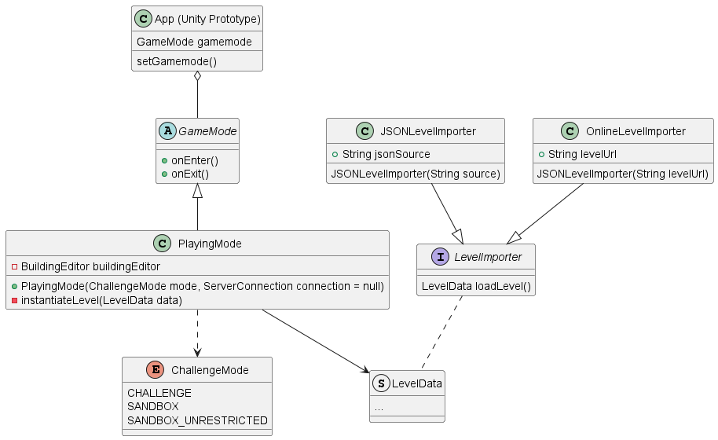
Subsystems - Class Diagram(s)
Possible Concepts/Patterns
FSM for game modes
Proxy for server connection
Service Locator to physics engine calls
Aggregation/Composition for game objects and entities
Factory for importing levels

Slide 7
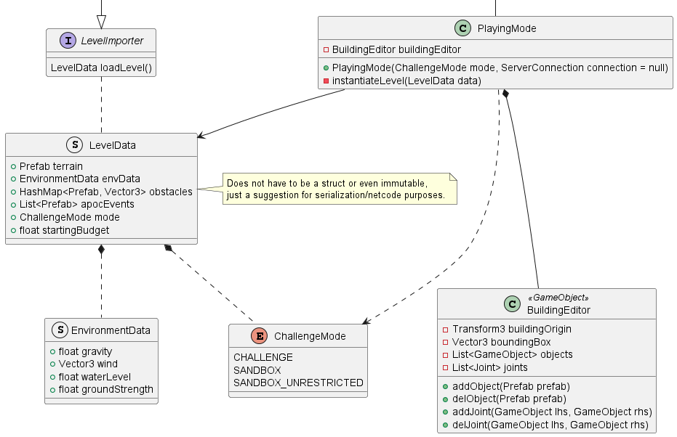
A Proxy can be used to create a local server to unify Singleplayer and Multiplayer builds
Unity focuses on Composition/Aggregation through GameObject’s rather than OOP using the Scripting engine.

Slide 8
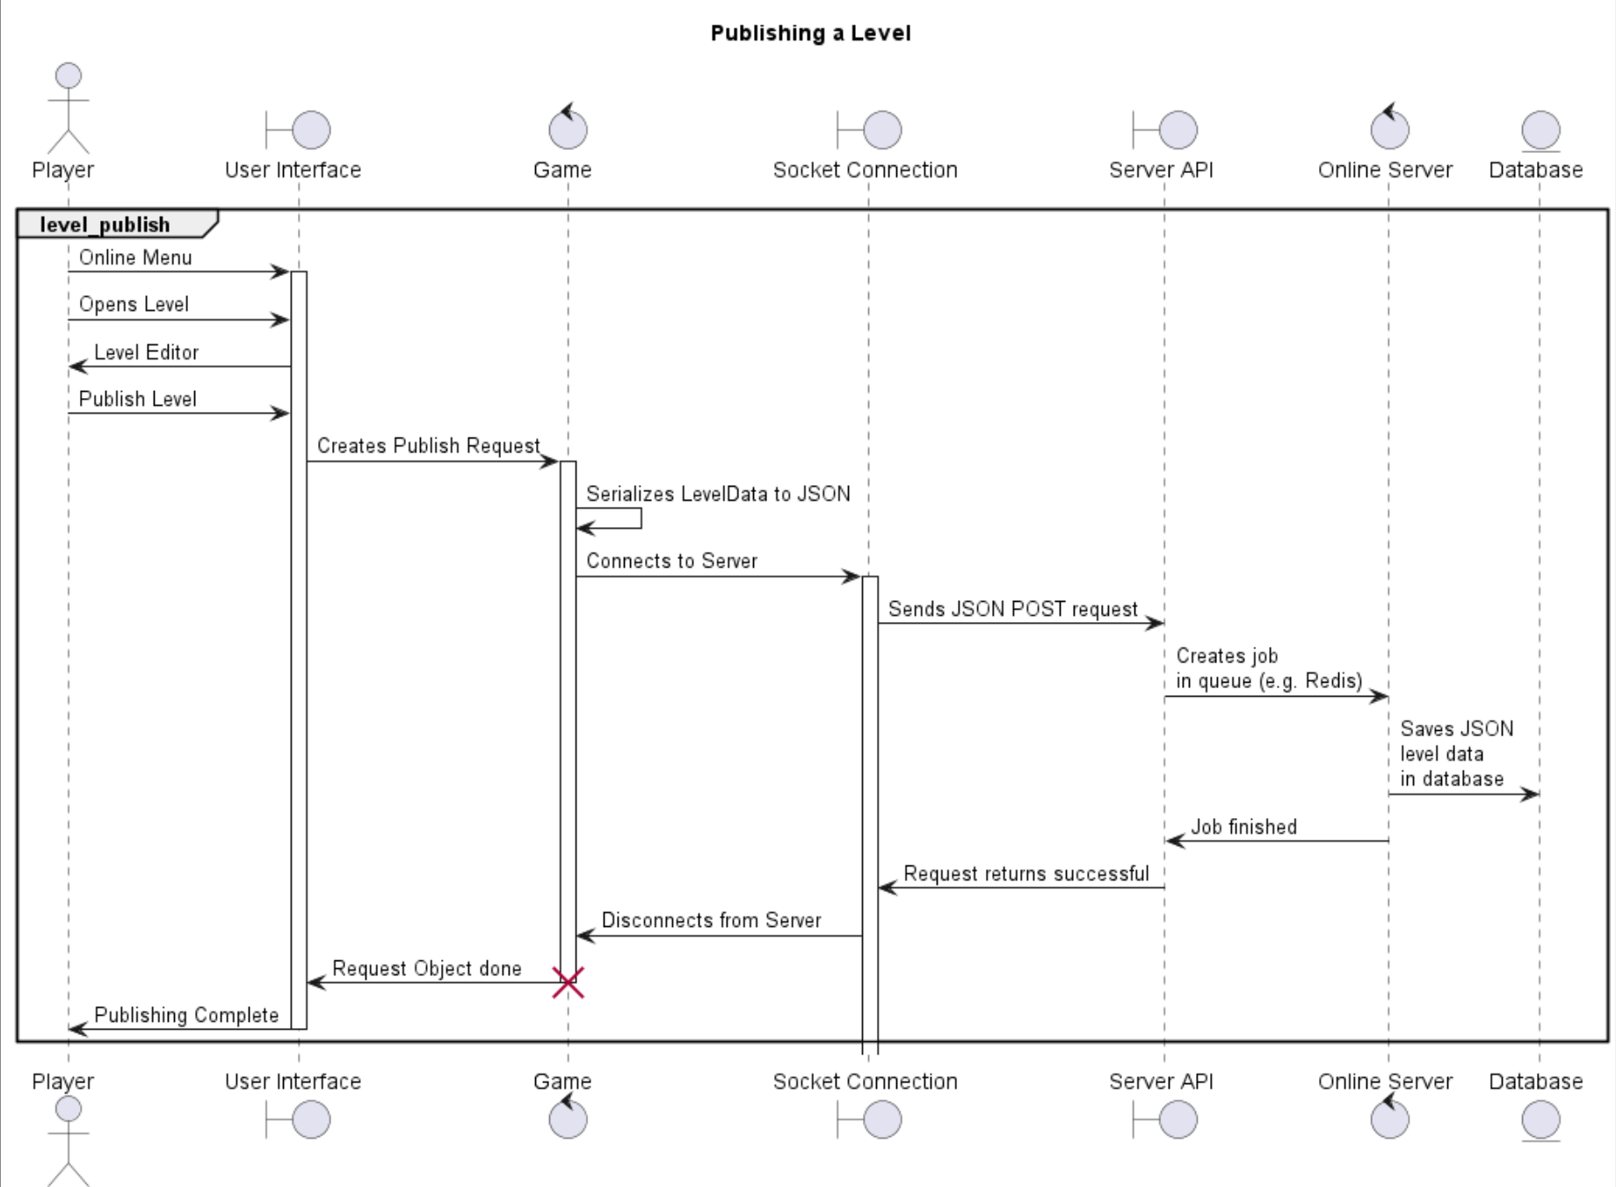
Auth session ID is already created at this point

Slide 9

Potential Issues
Some Factors that could cause uncertainty or significant issues in Make or Break’s development and success are:
Hardware Compatibility: Consistent performance across varying hardware configurations
Resource Constraints: Limited budgets, time or personnel
Technological Dependencies: Reliance on third party technologies for physics simulations, rendering, multiplayer support, etc.
User Feedback: Affects future updates, features, marketing strategies, etc.

Slide 10
Important Terms
Player: person who buys and plays the game on their system.
Deterministic physics: physics where the outcome is solely determined by the inputs. (no randomness)
Updates/Mods: modifications made to the game post-release, (mods usually by players, and updates/patches by developers)
Real-Time Simulation: Changes made by players are immediately reflected in the game’s environment

